Slide 1

22년 삼성 AI 전문가과정
6월 9일 목요일 1교시
장병탁
인공지능
16차시 : Deep Learning
서울대학교 컴퓨터공학부
담당 교수: 장병탁
Seoul National University
Byoung-Tak Zhang

Slide 2
Lecture Overview
인공지능
16차시 : Deep Learning
서울대학교 컴퓨터공학부
담당 교수: 장병탁
Seoul National University
Byoung-Tak Zhang

Slide 3
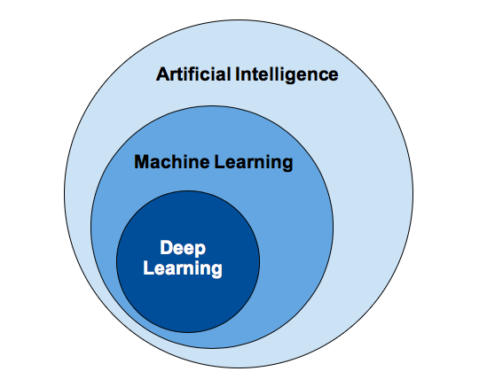
Introduction: Deep Learning
Machine Learning (Previous lecture)
Machine learning improves its performance after observations about the world
Models: decision trees, linear models, nonparametric models, ensemble models, etc.
Deep Learning (This lecture)
Deep learning is a broad family of techniques for ML
The word “deep” refers to the fact that the circuits are typically organized into many layers
Applications: visual object recognition, machine translation, speech recognition, etc.
Models: feedforward neural networks, convolutional neural networks, recurrent neural networks, etc.

Slide 4
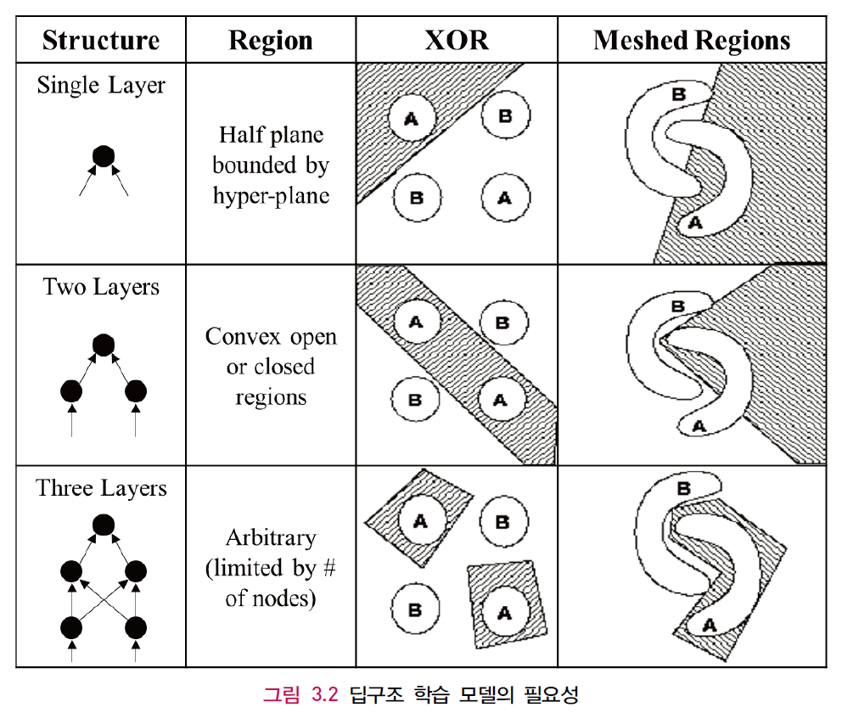
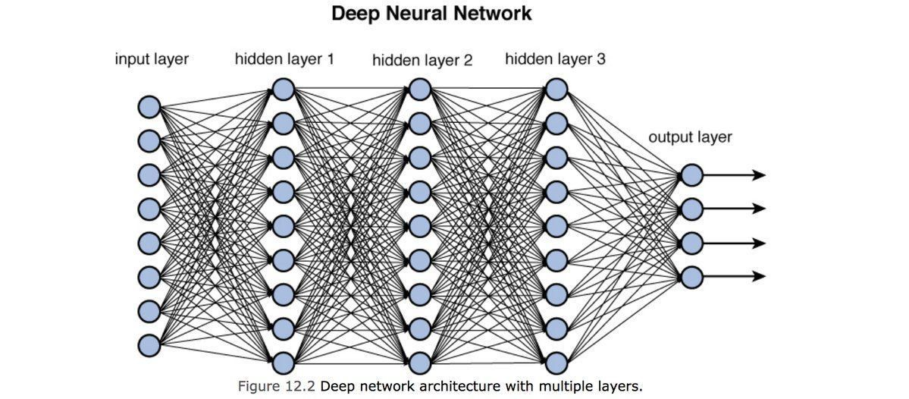
Why Deep Learning?
Why Deep Learning?
Expressive power of deep models
Stacking many layers can generate highly-complex nonlinear decision boundaries that separate the complex patterns in the data
출처: Figure #2

Slide 5
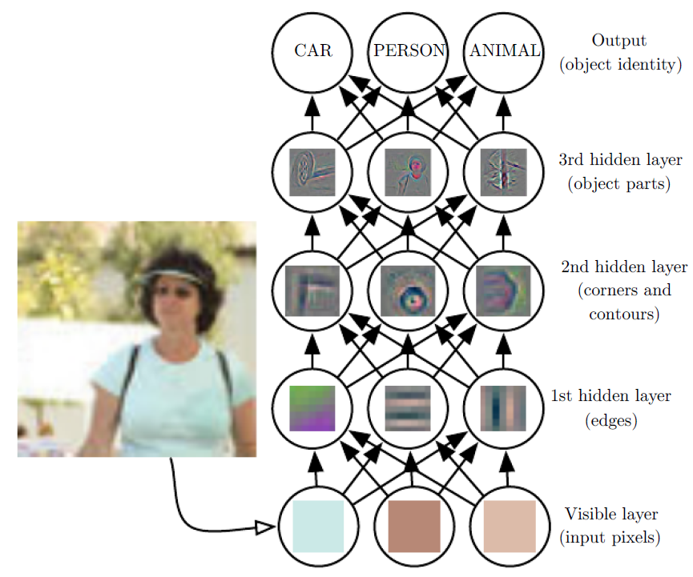
Computation Graphs for Deep Learning
Hidden layers
Values computed at each layer of the network is a different representation for the input x
Example: a network learning to recognize complex objects in images may form internal layers that detect useful subunits: edges, corners, ellipses, eyes, faces—cats
출처: Figure #8

Slide 6
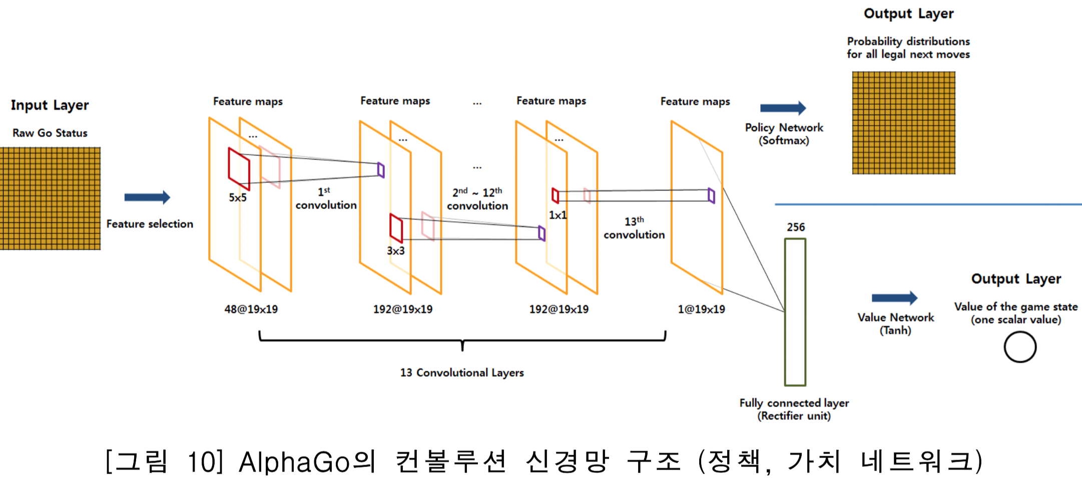
Applications
AlphaGo
Deep learning + reinforcement learning, deep Q-network, value network, policy network, policy gradient
출처: Figure #25

Slide 7
Outline (Lecture 16)
16.1 Simple Feedforward Networks .......................................
16.2 Computation Graphs for Deep Learning ........................
16.3 Convolutional Networks .................................................
16.4 Learning Algorithms .......................................................
16.5 Generalization .................................................................
16.6 Recurrent Neural Networks ............................................
16.7 Unsupervised Learning and Transfer Learning ..............
16.8 Applications ....................................................................
Summary .................................................................................
7
15
20
28
30
34
37
42
51

Slide 8
16.1 Simple Feedforward Networks

Slide 9
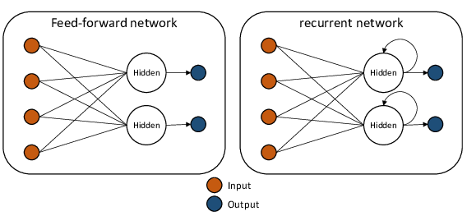
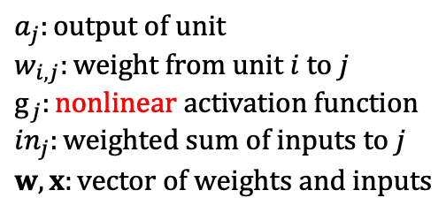
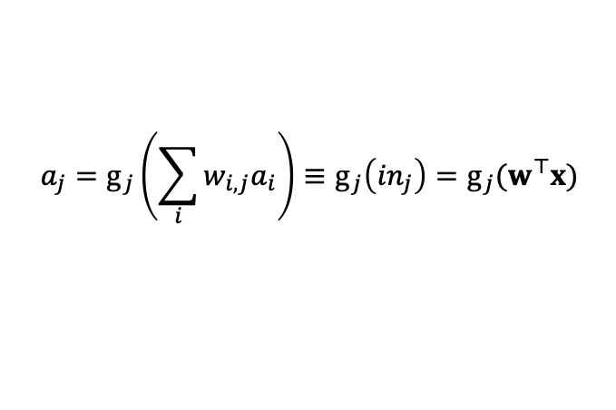
16.1 Simple Feedforward Networks (1/7)
Feedforward Network
Feedforward network
has connections only in one direction—directed acyclic graph
Recurrent network
feeds its intermediate or final outputs back into its own inputs
Unit
Weighted sum of the inputs from predecessor nodes + nonlinear function
출처: Figure #2
$$a_{j}:output of unit$$
$$w_{i,j}:weight from unit i to j$$
$$g_{j}:nonlinear activation function$$
$${in}_{j}:weighted sum of inputs to j$$
$$w, x:vector of weights and inputs$$
$$a_{j}=g_{j}\left(\sum_{i}{w_{i,j}a_{i}}\right)≡g_{j}\left({in}_{j}\right)=g_{j}(w^{⊤}x)$$

Slide 10
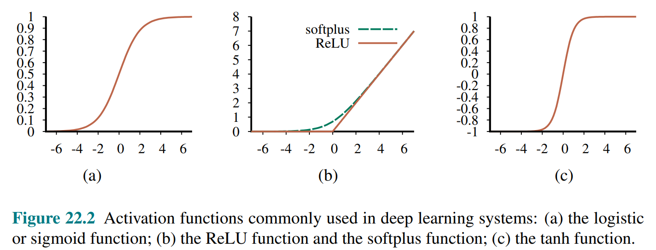
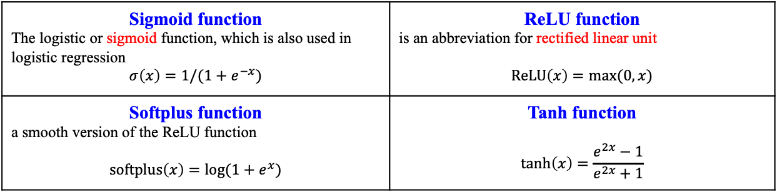
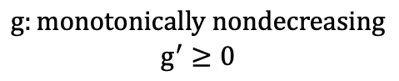
16.1 Simple Feedforward Networks (2/7)
Activation functions
Sigmoid function The logistic or sigmoid function, which is also used in logistic regression $$σ\left(x\right)=1/(1+e^{−x})$$ | ReLU function is an abbreviation for rectified linear unit $$ReLU\left(x\right)=max(0,x)$$
Softplus function a smooth version of the ReLU function $$softplus\left(x\right)=log(1+e^{x})$$ | Tanh function $$\tanh\left(x\right)=\frac{e^{2x}−1}{e^{2x}+1}$$
$$g:monotonically nondecreasing$$
$$g^{′}≥0$$
출처: Figure #3

Slide 11
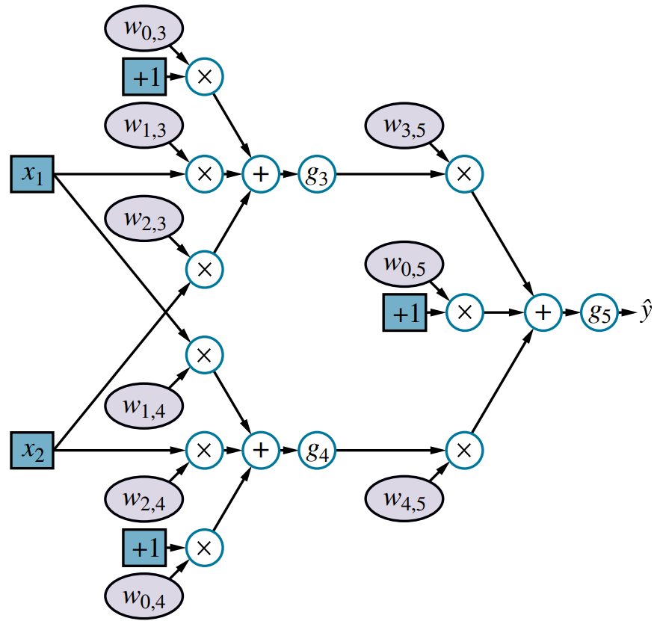
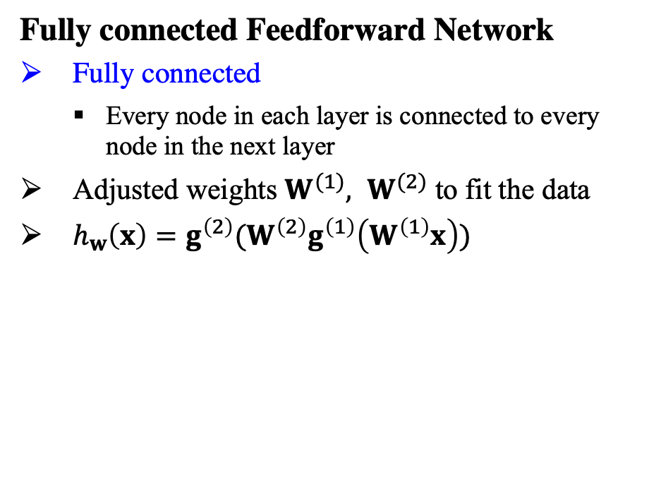
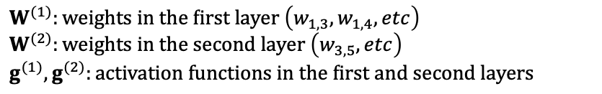
16.1 Simple Feedforward Networks (3/7)
Fully connected Feedforward Network
Fully connected
Every node in each layer is connected to every node in the next layer
Adjusted weights $W^{(1)}, W^{(2)}$ to fit the data
$h_{w}\left(x\right)=g^{\left(2\right)}(W^{\left(2\right)}g^{\left(1\right)}\left(W^{\left(1\right)}x\right))$
$W^{(1)}:weights in the first layer \left(w_{1,3},w_{1,4}, etc\right)$
$W^{(2)}:weights in the second layer \left(w_{3,5}, etc\right)$
$g^{(1)},g^{(2)}:activation functions in the first and second layers$
출처: Figure #4
Not every network is fully connected!
See Section 22.3 that choosing the connectivity of the network is also important in achieving effective learning

Slide 12
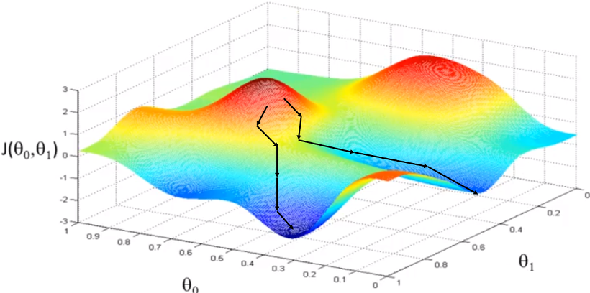
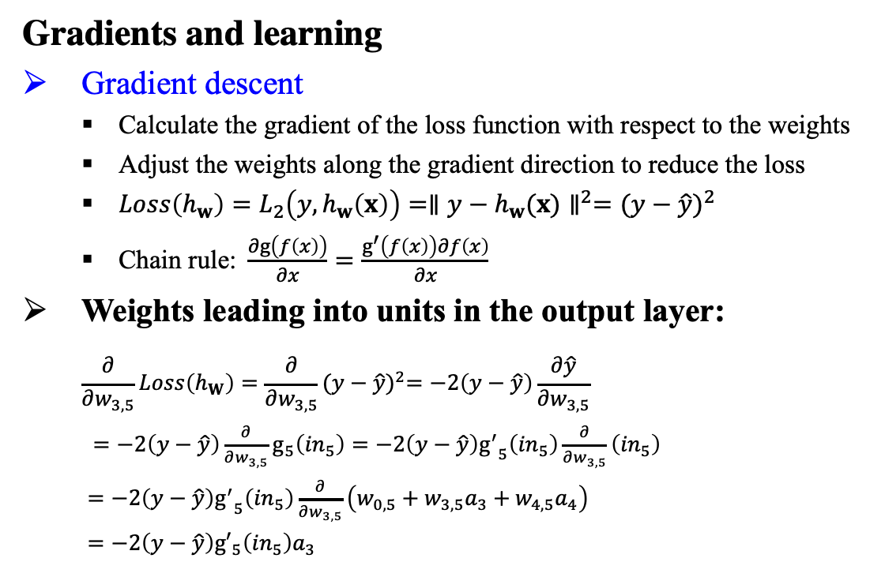
16.1 Simple Feedforward Networks (4/7)
Gradients and learning
Gradient descent
Calculate the gradient of the loss function with respect to the weights
Adjust the weights along the gradient direction to reduce the loss
$Loss\left(h_{w}\right)=L_{2}\left(y,h_{w}\left(x\right)\right)={∥y−h_{w}(x)∥}^{2}={(y−\hat{y})}^{2}$
$\text{Chain} \text{rule}\text{: }\frac{∂g\left(f\left(x\right)\right)}{∂x}=\frac{g^{′}\left(f\left(x\right)\right)∂f\left(x\right)}{∂x}$
$\text{Weights} \text{leading} \text{into} \text{units} \text{in} \text{the} \text{output} \text{layer}\text{:}$
$$\frac{∂}{∂w_{3,5}}Loss\left(h_{W}\right)=\frac{∂}{∂w_{3,5}}{(y−\hat{y})}^{2}=−2\left(y−\hat{y}\right)\frac{∂\hat{y}}{∂w_{3,5}}$$
$=−2\left(y−\hat{y}\right)\frac{∂}{∂w_{3,5}}g_{5}\left({in}_{5}\right)=−2\left(y−\hat{y}\right){g^{′}}_{5}\left({in}_{5}\right)\frac{∂}{∂w_{3,5}}\left({in}_{5}\right)$
$=−2\left(y−\hat{y}\right){g^{′}}_{5}\left({in}_{5}\right)\frac{∂}{∂w_{3,5}}\left(w_{0,5}+w_{3,5}a_{3}+w_{4,5}a_{4}\right)$
$=−2\left(y−\hat{y}\right){g′}_{5}\left({in}_{5}\right)a_{3}$
출처: Figure #4

Slide 13
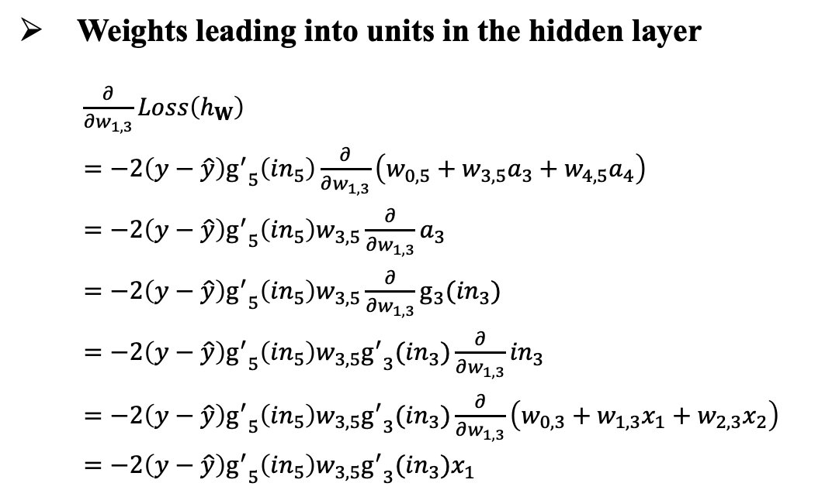
16.1 Simple Feedforward Networks (5/7)
Weights leading into units in the hidden layer
$\frac{∂}{∂w_{1,3}}Loss\left(h_{W}\right)$
$=−2\left(y−\hat{y}\right){g^{′}}_{5}\left({in}_{5}\right)\frac{∂}{∂w_{1,3}}\left(w_{0,5}+w_{3,5}a_{3}+w_{4,5}a_{4}\right)$
$=−2\left(y−\hat{y}\right){g^{′}}_{5}\left({in}_{5}\right)w_{3,5}\frac{∂}{∂w_{1,3}}a_{3}$
$=−2\left(y−\hat{y}\right){g^{′}}_{5}\left({in}_{5}\right)w_{3,5}\frac{∂}{∂w_{1,3}}g_{3}({in}_{3})$
$=−2\left(y−\hat{y}\right){g^{′}}_{5}\left({in}_{5}\right)w_{3,5}{g^{′}}_{3}({in}_{3})\frac{∂}{∂w_{1,3}}{in}_{3}$
$=−2\left(y−\hat{y}\right){g^{′}}_{5}\left({in}_{5}\right)w_{3,5}{g^{′}}_{3}({in}_{3})\frac{∂}{∂w_{1,3}}\left(w_{0,3}+w_{1,3}x_{1}+w_{2,3}x_{2}\right)$
$=−2\left(y−\hat{y}\right){g^{′}}_{5}\left({in}_{5}\right)w_{3,5}{g^{′}}_{3}({in}_{3})x_{1}$
출처: Figure #4
For multiple examples, the gradient is just the sum of the gradients for the individual examples

Slide 14
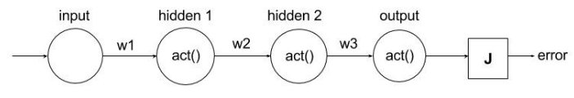
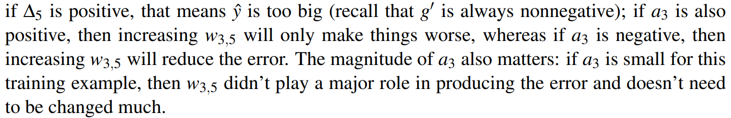
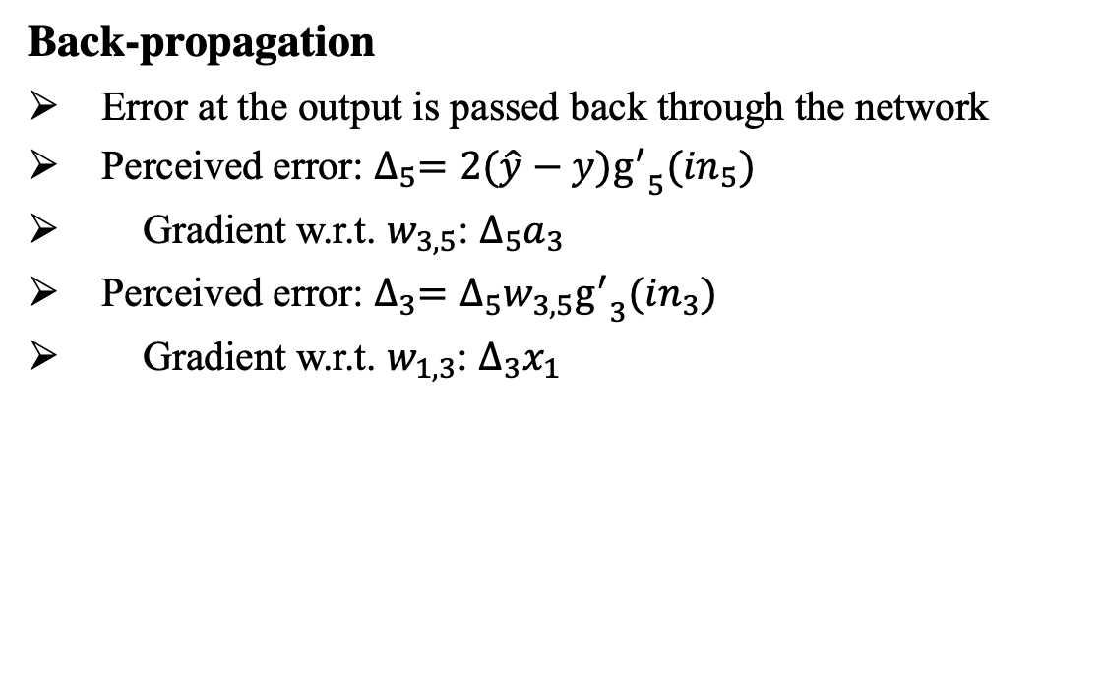
16.1 Simple Feedforward Networks (6/7)
Back-propagation
Error at the output is passed back through the network
Perceived error: $∆_{5}=2(\hat{y}−y){g^{′}}_{5}({in}_{5})$
Gradient w.r.t. $w_{3,5}$: $∆_{5}a_{3}$
Perceived error: $∆_{3}=∆_{5}w_{3,5}{g^{′}}_{3}({in}_{3})$
Gradient w.r.t. $w_{1,3}$: $∆_{3}x_{1}$
Reading assignment (from textbook 807pg)
출처: Figure #5
출처: Figure #6

Slide 15
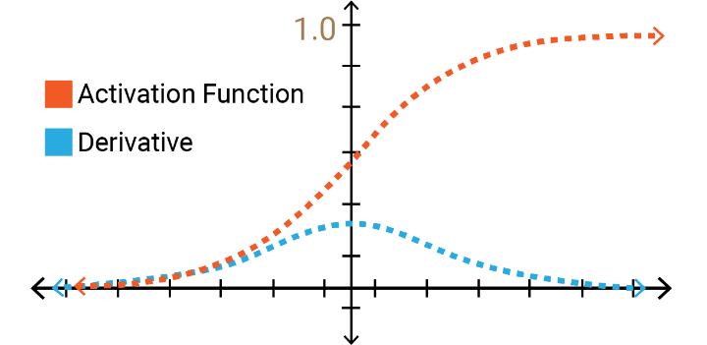
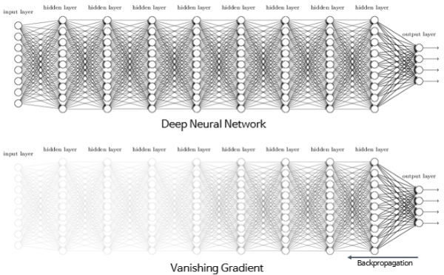
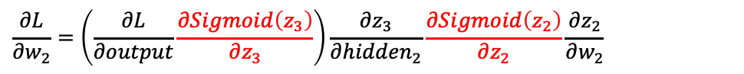
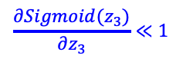
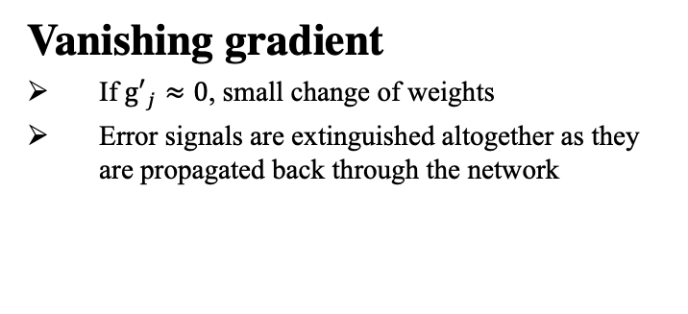
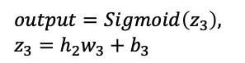
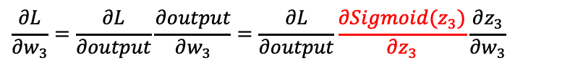
16.1 Simple Feedforward Networks (7/7)
Vanishing gradient
If ${g′}_{j}≈0$, small change of weights
Error signals are extinguished altogether as they are propagated back through the network
$$\frac{∂Sigmoid(z_{3})}{∂z_{3}}≪1$$
출처: Figure #7
$$output=Sigmoid\left(z_{3}\right),$$
$$z_{3}=h_{2}w_{3}+b_{3}$$
$$\frac{∂L}{∂w_{3}}=\frac{∂L}{∂output}\frac{∂output}{∂w_{3}}=\frac{∂L}{∂output}\frac{∂Sigmoid(z_{3})}{∂z_{3}}\frac{∂z_{3}}{∂w_{3}}$$
$$\frac{∂L}{∂w_{2}}=\left(\frac{∂L}{∂output}\frac{∂Sigmoid\left(z_{3}\right)}{∂z_{3}}\right)\frac{∂z_{3}}{∂{hidden}_{2}}\frac{∂Sigmoid\left(z_{2}\right)}{∂z_{2}}\frac{∂z_{2}}{∂w_{2}}$$
Vanishing gradient
$$\frac{∂L}{∂w_{1}}=\left(\left(\frac{∂L}{∂output}\frac{∂Sigmoid\left(z_{3}\right)}{∂z_{3}}\right)\frac{∂z_{3}}{∂{hidden}_{2}}\frac{∂Sigmoid\left(z_{2}\right)}{∂z_{2}}\right)\frac{∂z_{2}}{∂hidden_{1}}\frac{∂Sigmoid\left(z_{1}\right)}{∂z_{1}}\frac{∂z_{1}}{∂w_{1}}$$

Slide 16
16.2 Computation Graphs for
Deep Learning

Slide 17
16.2 Computation Graphs for Deep Learning (1/4)
Basic idea of deep learning
Represents hypotheses as computation graphs with tunable weights
Computes gradient of the loss function w.r.t. those weights to fit the data
Input encoding
Boolean attributes: true, false mapped to 1, 0 or +1, -1
Numeric attributes (integer or real-valued): used as is or maybe scaled to fit within a fixed range (log scale)
Categorical attributes with more than two values: one-hot encoding
Where {French, Italian, Thai} encodes Thai as 001 and encodes French as 100

Slide 18
16.2 Computation Graphs for Deep Learning (2/4)
Hidden layers
Values computed at each layer of the network is a different representation for the input x
Example: a network learning to recognize complex objects in images may form internal layers that detect useful subunits: edges, corners, ellipses, eyes, faces—cats
출처: Figure #8

Slide 19
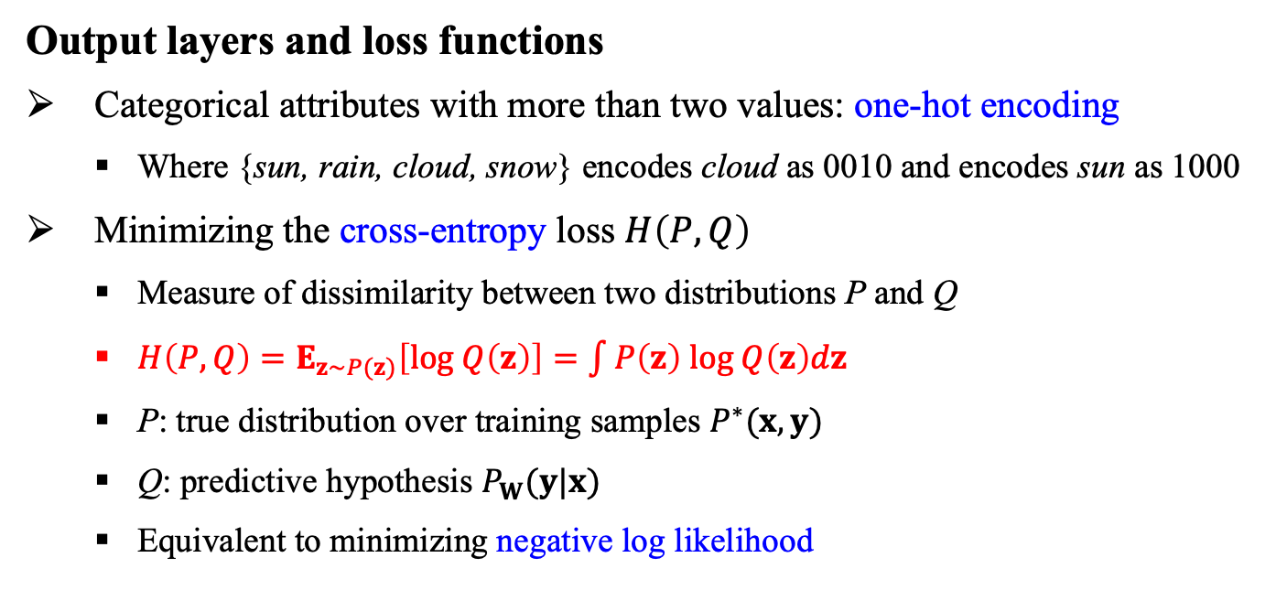
16.2 Computation Graphs for Deep Learning (3/4)
Output layers and loss functions
Categorical attributes with more than two values: one-hot encoding
Where {sun, rain, cloud, snow} encodes cloud as 0010 and encodes sun as 1000
Minimizing the cross-entropy loss $H\left(P,Q\right)$
Measure of dissimilarity between two distributions P and Q
$H\left(P,Q\right)=E_{z\sim P(z)}\left[log Q\left(z\right)\right]=\int{P\left(z\right) log Q\left(z\right)dz}$
P: true distribution over training samples $P^{∗}(x,y)$
Q: predictive hypothesis $P_{W}(y|x)$
Equivalent to minimizing negative log likelihood

Slide 20
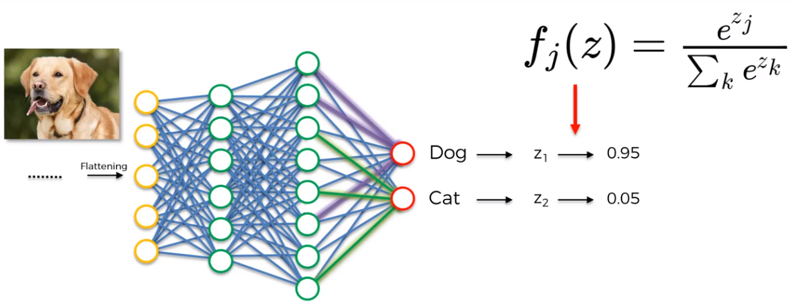
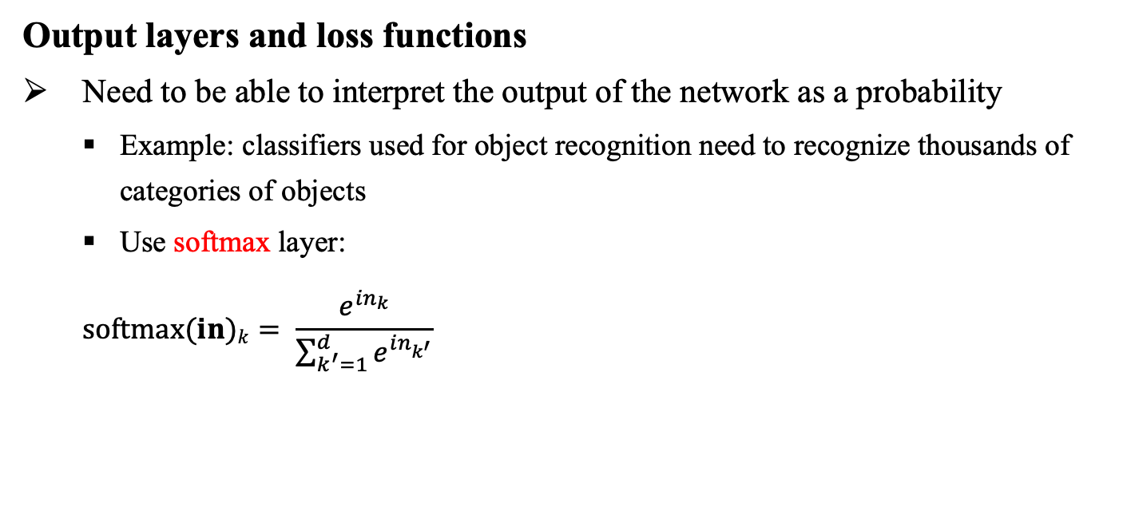
16.2 Computation Graphs for Deep Learning (4/4)
Output layers and loss functions
Need to be able to interpret the output of the network as a probability
Example: classifiers used for object recognition need to recognize thousands of categories of objects
Use softmax layer:
$$softmax(in)k= \frac{e^{{in}_{k}}}{\sum_{k^{′}=1}^{d}{e^{{in}_{k^{′}}}}}$$
출처: Figure #9

Slide 21
16.3 Convolutional Networks

Slide 22
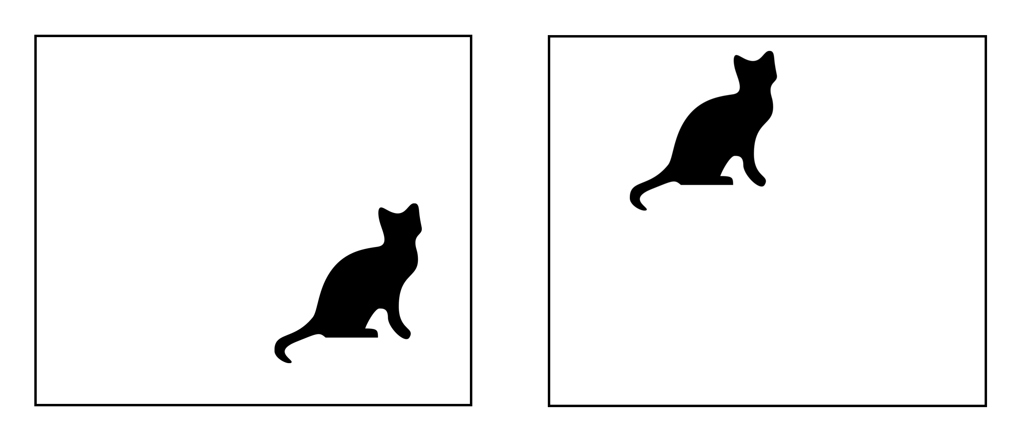
16.3 Convolutional Networks (1/7)
Motivation
Image not a simple vector since adjacency of pixels
A network with fully connected layers = training with randomly permuted pixels (no locality)
Vast parameter space with huge computational budget
Solution: each hidden unit receives input from only a small, local region of the image
Spatial invariance
Detect the same feature wherever it appear in the image
Weight sharing: Weights connecting a local region to a unit in the hidden layer to be the same for each hidden unit
Cat
=
Cat
Spatial invariance

Slide 23
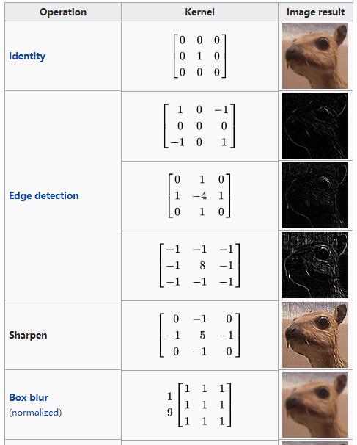
16.3 Convolutional Networks (2/7)
Kernel and Convolution
Kernel
A pattern of weights that is replicated across multiple local regions
Convolution
Process of applying the kernel to the pixels of the image
i.e. slide over the image spatially, to find shift-invariant patterns

Slide 24
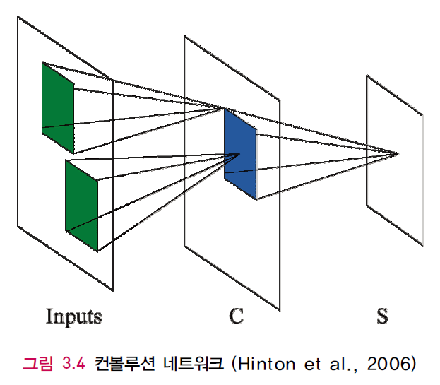
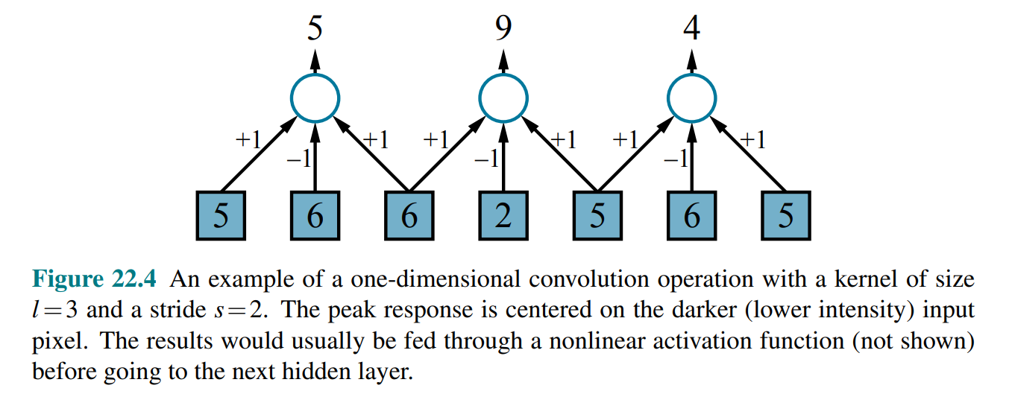
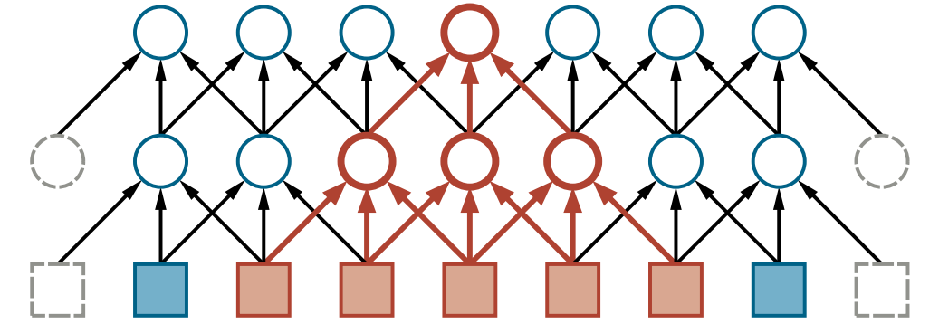
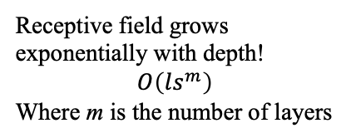
16.3 Convolutional Networks (3/7)
Convolutional operation
Receptive field (shown in red)
Feature map
출처: Figure #9
출처: Figure #10
Receptive field grows exponentially with depth!
$$O\left(ls^{m}\right)$$
Where m is the number of layers
출처: Figure #11

Slide 25
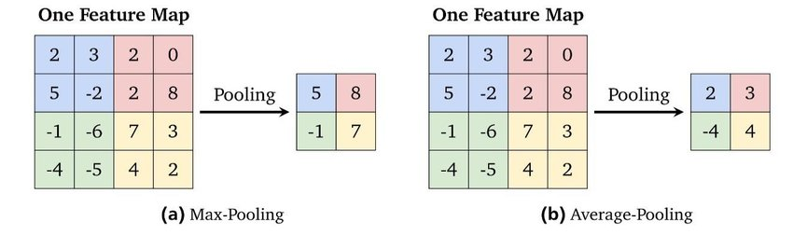
16.3 Convolutional Networks (4/7)
Pooling and down-sampling
Pooling layer
Summarizes a set of adjacent units with a single value to down-sample it
Reduces the number of weights required in subsequent layers
Max pooling, average pooling, min pooling, L2-norm pooling, etc.
출처: Figure #12

Slide 26
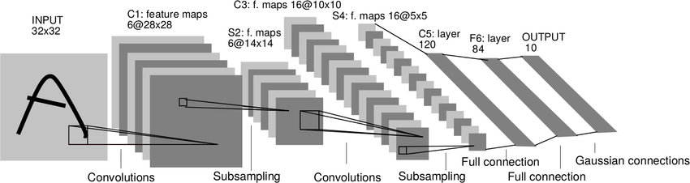
16.3 Convolutional Networks (5/7)
Total structure of ConvNet (CNN)
Convolution layer, subsampling (pooling) layer, fully-connected layer
Feature maps, dimension reduction, classification
CNN for recognizing the character image “A” (LeCun et al., 1998)
출처: Figure #13

Slide 27
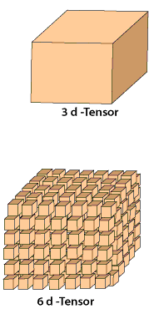
16.3 Convolutional Networks (6/7)
Tensor operations in CNNs
Tensor: multidimensional arrays of any dimension
Vectors (one-dimensional) and matrices (two-dimensional) tensors
Image: (H, W, D) 3D tensor shape
GPU, TPU make available a high degree of parallelism
Example
Training a 256×256 RGB image with mini batch size of 64
: 4D tensor of tensor size 256×256×3×64
Apply 96 kernels of size 5×5×3 with a stride of 2
: output tensor of size 128×128×96×64

Slide 28
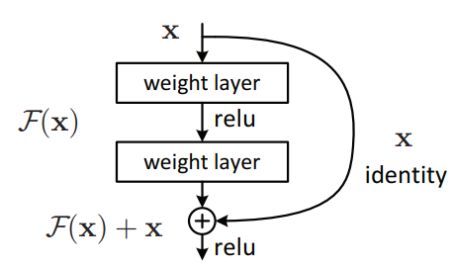
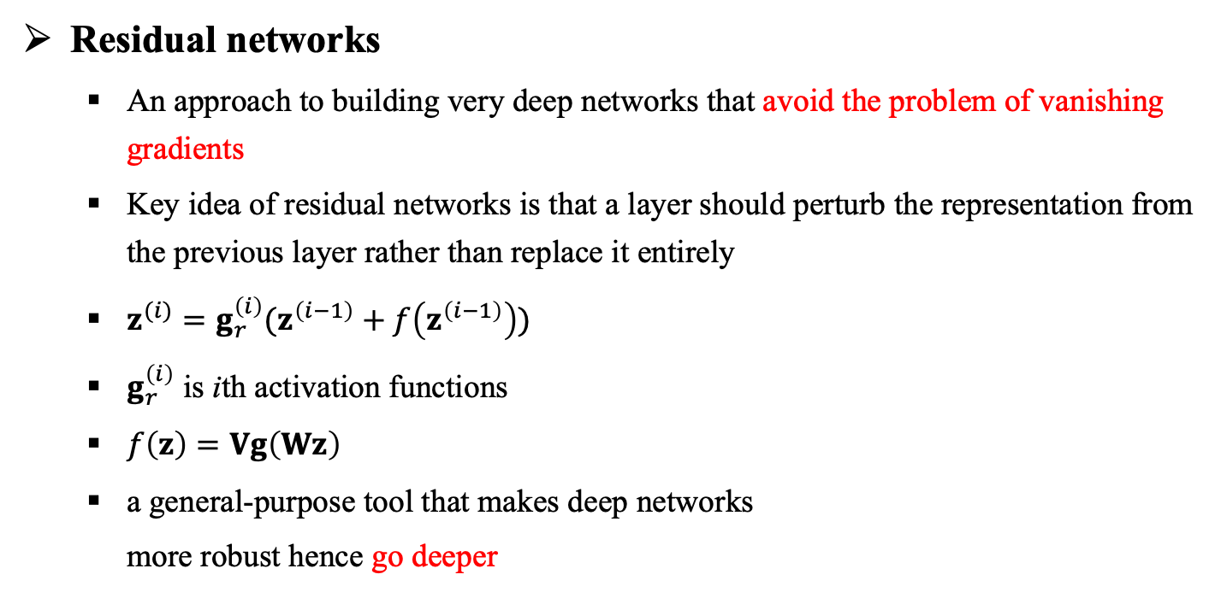
16.3 Convolutional Networks (7/7)
Residual networks
An approach to building very deep networks that avoid the problem of vanishing gradients
Key idea of residual networks is that a layer should perturb the representation from the previous layer rather than replace it entirely
$z^{(i)}=g_{r}^{\left(i\right)}(z^{\left(i−1\right)}+f\left(z^{\left(i−1\right)}\right))$
$g_{r}^{\left(i\right)}$ is ith activation functions
$f\left(z\right)=Vg\left(Wz\right)$
a general-purpose tool that makes deep networks
more robust hence go deeper
출처: Figure #14

Slide 29
16.4 Learning Algorithms

Slide 30
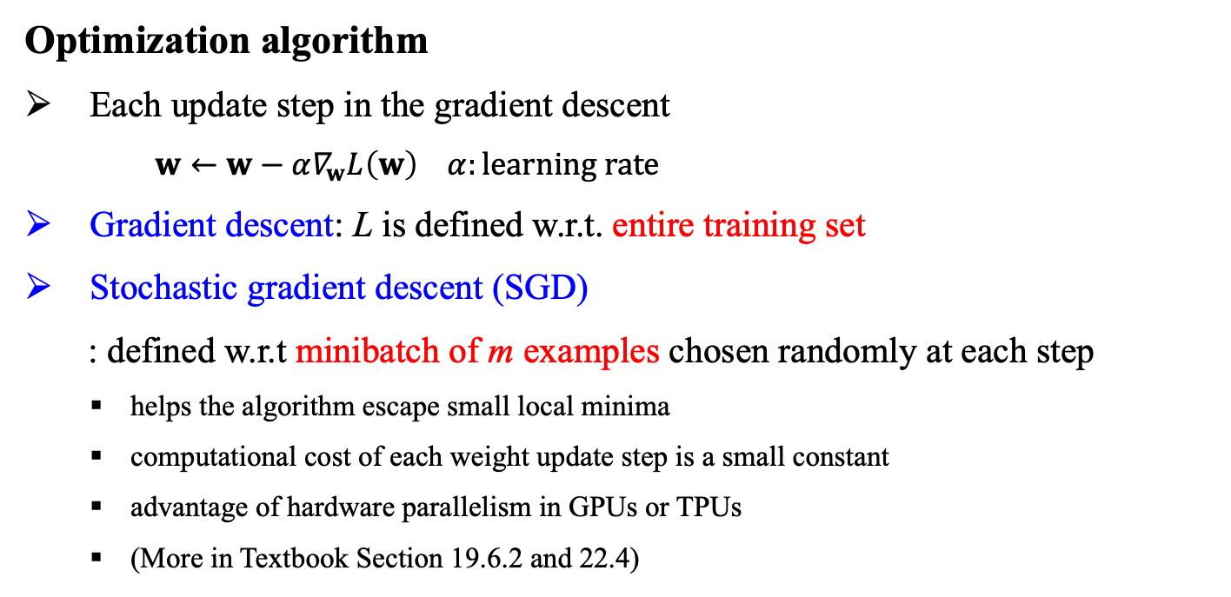
16.4 Learning Algorithms (1/1)
Optimization algorithm
Each update step in the gradient descent
$w←w−α∇_{w}L\left(w\right) α:learning rate$
Gradient descent: L is defined w.r.t. entire training set
Stochastic gradient descent (SGD)
: defined w.r.t minibatch of m examples chosen randomly at each step
helps the algorithm escape small local minima
computational cost of each weight update step is a small constant
advantage of hardware parallelism in GPUs or TPUs
(More in Textbook Section 19.6.2 and 22.4)
Training a neural network =
modifying the network’s parameters so as to minimize the loss function

Slide 31
16.5 Generalization

Slide 32
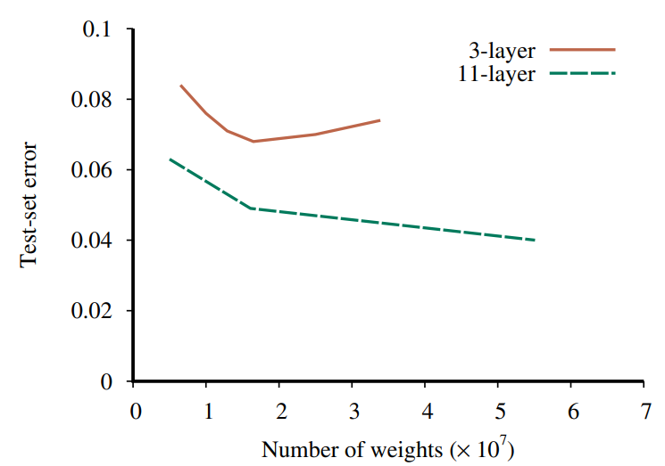
16.5 Generalization (1/3)
Choosing a network architecture
Neural network architectures designed to generalize on particular type of data
CNN: same feature extractor is useful at all locations across a spatial grid (e.g. image)
RNN: same update rule is useful at all points in a stream of sequential data (e.g. text, audio)
Depth matters

Slide 33
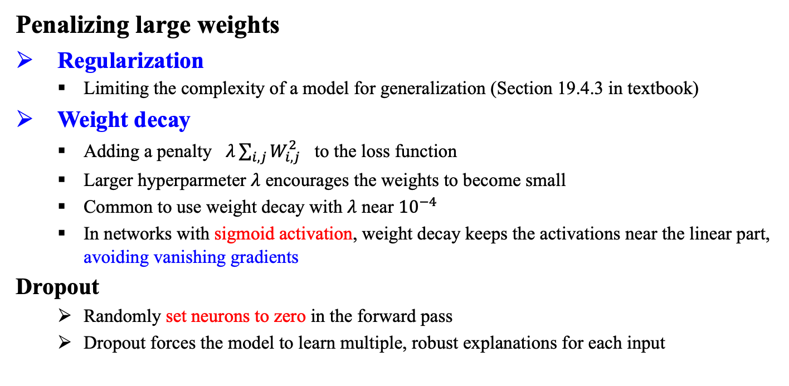
16.5 Generalization (2/3)
Penalizing large weights
Regularization
Limiting the complexity of a model for generalization (Section 19.4.3 in textbook)
Weight decay
Adding a penalty $λ\sum_{i,j}{W_{i,j}^{2}}$ to the loss function
Larger hyperparmeter $λ$ encourages the weights to become small
Common to use weight decay with $λ$ near ${10}^{−4}$
In networks with sigmoid activation, weight decay keeps the activations near the linear part, avoiding vanishing gradients
Dropout
Randomly set neurons to zero in the forward pass
Dropout forces the model to learn multiple, robust explanations for each input

Slide 34
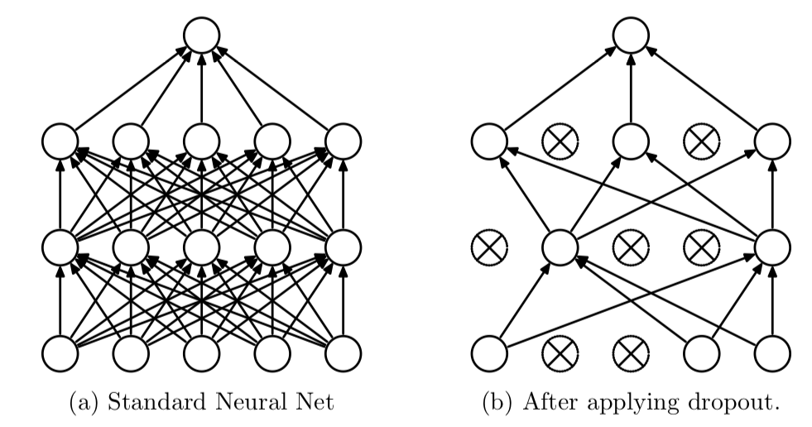
16.5 Generalization (3/3)
Dropout
Randomly set neurons to zero in the forward pass
No change in backward pass
Dropout forces the model to learn multiple, robust explanations for each input
One of regularization techniques
출처: Figure #15

Slide 35
16.6 Recurrent Neural Networks

Slide 36
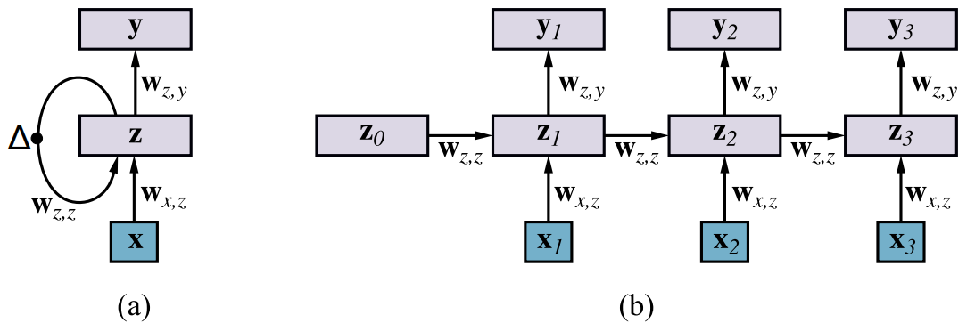
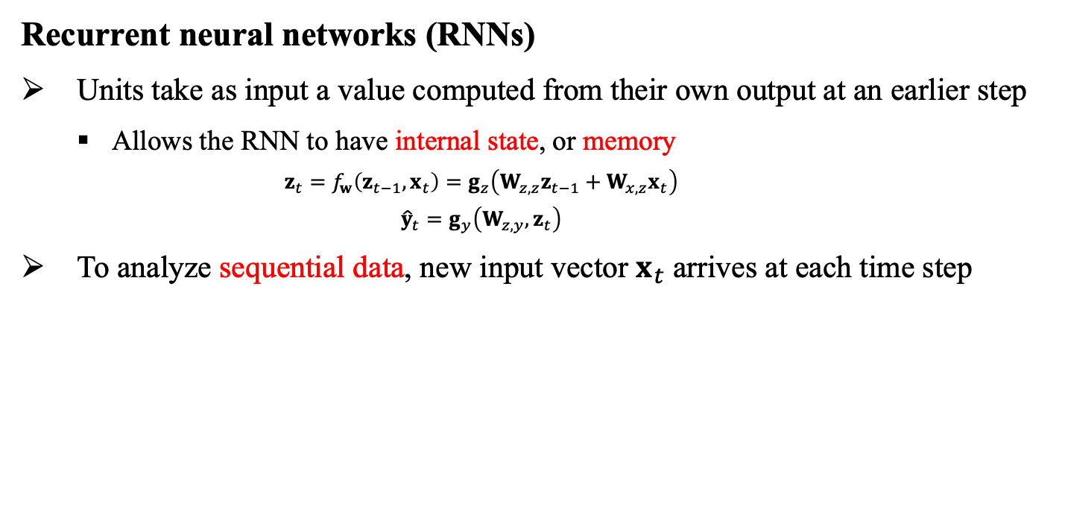
16.6 Recurrent Neural Networks (1/2)
Recurrent neural networks (RNNs)
Units take as input a value computed from their own output at an earlier step
Allows the RNN to have internal state, or memory
$$z_{t}=f_{w}\left(z_{t−1},x_{t}\right)=g_{z}\left(W_{z,z}z_{t−1}+W_{x,z}x_{t}\right)$$
$${\hat{y}}_{t}=g_{y}\left(W_{z,y},z_{t}\right)$$
To analyze sequential data, new input vector $x_{t}$ arrives at each time step
Output layer
Hidden layer
Input layer
출처: Figure #16

Slide 37

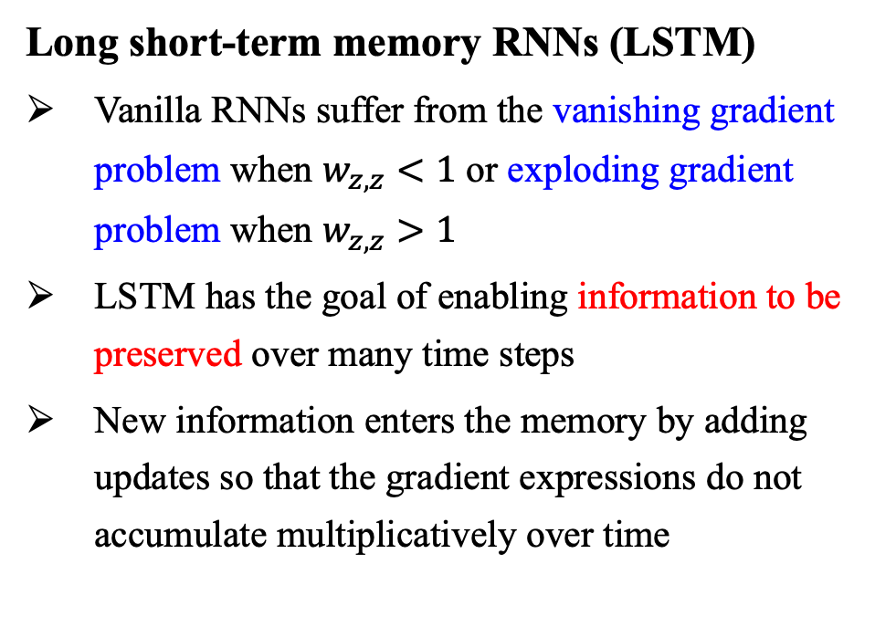
16.6 Recurrent Neural Networks (2/2)
Long short-term memory RNNs (LSTM)
Vanilla RNNs suffer from the vanishing gradient problem when $w_{z,z}<1$ or exploding gradient problem when $w_{z,z}>1$
LSTM has the goal of enabling information to be preserved over many time steps
New information enters the memory by adding updates so that the gradient expressions do not accumulate multiplicatively over time
출처: Figure #17

Slide 38
16.7 Unsupervised Learning and Transfer Learning

Slide 39
16.7 Unsupervised Learning and Transfer Learning (1/4)
Deep learning systems we have discussed so far are based on supervised learning but…
Supervised learning
Requires each training example to be labeled
Often requires far more labeled data than a human would for the same task
A child needs to see only one picture of a giraffe to recognize giraffes
Large data sets usually require scarce and expensive human labor

Slide 40
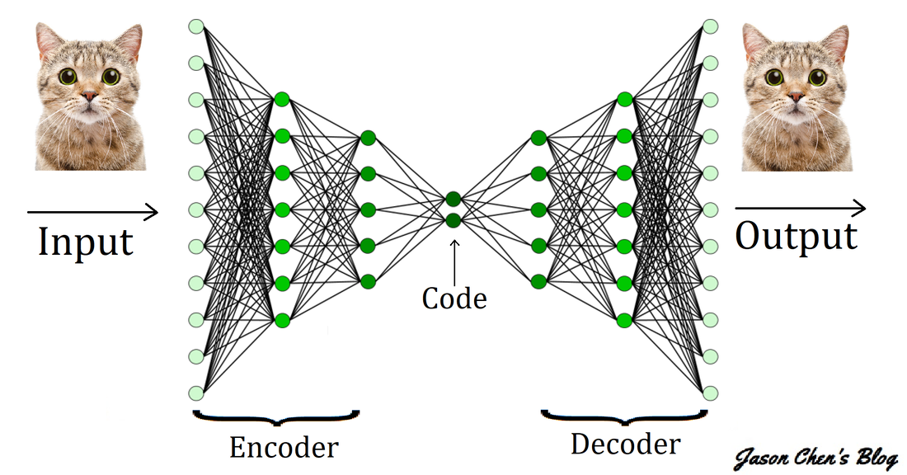
16.7 Unsupervised Learning and Transfer Learning (2/4)
Unsupervised learning
Learns solely from unlabeled inputs x
Produces generative models, which can produce realistic text, images, audio, and video
Example
Probabilistic PCA, autoencoders,
deep autoregressive models,
generative adversarial networks (GANs),
unsupervised translation
출처: Figure #18

Slide 41
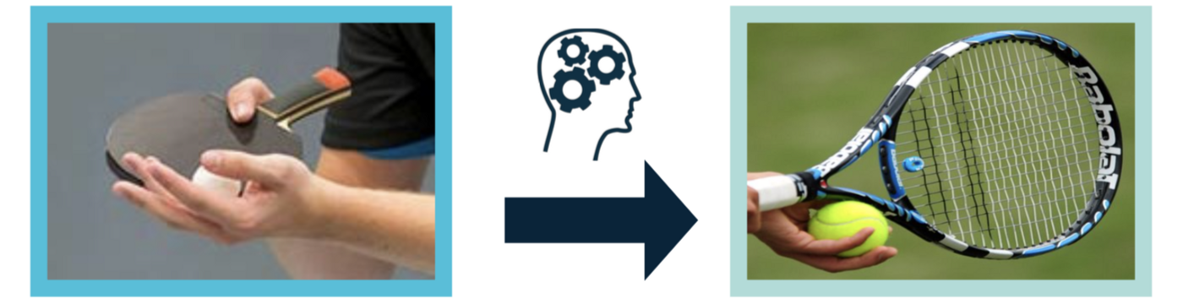
16.7 Unsupervised Learning and Transfer Learning (3/4)
Transfer learning
Requires some labeled examples but is able to improve their performance further by studying labeled examples for different tasks
Motivation
A person who has already learned to play table tennis will find it easier to learn related sports such as tennis
Usage example
Copy over the weights learned for task A to a network that will be trained for task B

Slide 42

16.7 Unsupervised Learning and Transfer Learning (4/4)
Semi-supervised learning
Requires some labeled examples but is able to improve their performance further by also studying unlabeled examples
출처: Figure #18

Slide 43
16.8 Applications

Slide 44



16.8 Applications (1/8)
1) ImageNet Challenge
ILSVRC (ImageNet Large-Scale Visual Recognition Challenge)
Image classification/localization, 1.2M labeled images, 1000 classes
출처: Figure #20
AlexNet (2012)
출처: Figure #18
GoogLeNet (2015)
출처: Figure #19

Slide 45
16.8 Applications (2/8)
2) AlexNet Breakthrough
Eight weighted layers (5 convolution layers, 3 fully connected layers)
GPU parallel processing: GTX 580 GPU (3GB) x 2
Single GPU is not capable of learning 1.2 million training images
Distributing the entire network to each GPU
3) Deeper and Deeper!
28.2
152 layers
25.8
16.4
11.7
22 layers
19 layers
6.7
7.3
3.57
8 layers
8 layers
shallow
출처: Figure #21
ILSVRC’15 ResNet
ILSVRC’14 GoogleNet
ILSVRC’14 VGG
ILSVRC’13
ILSVRC’12 AlexNet
ILSVRC’11
ILSVRC’10

Slide 46

16.8 Applications (3/8)
4) Speech Recognition
~2010 GMM-HMM
(Dynamic Bayesian Models)
~2013 DNN-HMM
(Deep Neural Networks)
~Current LSTM-RNN layers
5 convolution layers
3 fully connected layers
출처: Figure #22

Slide 47

16.8 Applications (4/8)
5) Face Recognition
Minimizing cross-entropy loss for each learning sample: L = - log p_{k}
Standard back-propagation algorithm and stochastic gradient descent (SGD)
Employing the ReLU activation function: max(0, x)
Sparsity: 75% of feature elements have 0 value
Guarantee of sparcity using dropout (generalization method)
출처: Figure #23

Slide 48


16.8 Applications (5/8)
6) Google Neural Machine Translation
NeuralMT, end-to-end learning, recurrent neural networks, GPUs
출처: Figure #24

Slide 49
16.8 Applications (6/8)
7) AlphaGo
Deep learning + reinforcement learning, deep Q-network, value network, policy network, policy gradient
출처: Figure #25

Slide 50


16.8 Applications (7/8)
8) Visual Storytelling (VIST)
Visual story = photo sequence + sentence sequence
SNU 1st Place in VIST Challenge 2018
Input:
Output:
The local market was a lot of fun.
There were so many different kind of things to choose from.
Some of the shops looked very interesting.
I bought a few souvenirs for the kids
My favorite part was the bike ride.
GLAC Net: GLocal Attention Cascading Networks for Multi-image Cued Story Generation, T. Kim et al. NAACL 2018 Workshop on Storytelling, 2018.
출처: Figure #26

Slide 51


16.8 Applications (8/8)
9) Image Synthesis by GAN (Generative Adversarial Nets): Videos

Slide 52
Summary
Methods for learning functions represented by deep computational graphs
Neural networks represent complex nonlinear functions with a network of parameterized linear-threshold units.
The back-propagation algorithm implements a gradient descent in parameter space to minimize the loss function.
Deep learning works well for visual object recognition, speech recognition, natural language processing, and reinforcement learning in complex environments.
Convolutional networks are particularly well suited for image processing and other tasks where the data have a grid topology.
Recurrent networks are effective for sequence-processing tasks including language modeling and machine translation.

Slide 53


References
Figures
#1, 2, 7, 10, 24 장병탁. 장교수의 딥러닝. 홍릉과학출판사, 2017.
#3, 4, 5, 6, 9, 11, 15, 16 Stuart J. Russell and Peter Norvig (2021). Artificial Intelligence: A Modern Approach (4rd Edition). Pearson
#8 LeCun, Y., Bengio, Y., Hinton, G., 2015. Deep learning. Nature 521, 436–444
#12 Stanford Lecture CS231n
#13 LeCun, Yann, et al. "Gradient-based learning applied to document recognition." Proceedings of the IEEE 86.11 (1998): 2278-2324.
#14 He, Kaiming, et al. "Deep residual learning for image recognition." Proceedings of the IEEE conference on computer vision and pattern recognition. 2016.
#15 Srivastava, Nitish, et al. "Dropout: a simple way to prevent neural networks from overfitting." The journal of machine learning research 15.1 (2014): 1929-1958.
#17 Colah’s blog. Understanding LSTM Networks
#18 Krizhevsky, Alex, Ilya Sutskever, and Geoffrey E. Hinton. "Imagenet classification with deep convolutional neural networks." Advances in neural information processing systems 25 (2012).

Slide 54
References
Figures
#19 Szegedy, Christian, et al. "Going deeper with convolutions." Proceedings of the IEEE conference on computer vision and pattern recognition. 2015.
#20 Krizhevsky, Alex, Ilya Sutskever, and Geoffrey E. Hinton. "Imagenet classification with deep convolutional neural networks." Advances in neural information processing systems 25 (2012).
#21 Delivering competitive advantage to companies creating and using vision and machine learning technology https://www.bdti.com/InsideDSP/2017/06/29/Microsoft
#22 https://scienceon.kisti.re.kr/srch/selectPORSrchReport.do?cn=TRKO201800042056
#23 Taigman, Yaniv, et al. "Deepface: Closing the gap to human-level performance in face verification." Proceedings of the IEEE conference on computer vision and pattern recognition. 2014.
#25 Silver, D., Huang, A., Maddison, C. et al. Mastering the game of Go with deep neural networks and tree search. Nature 529, 484–489 (2016)
#26 Kim, Taehyeong, et al. "Glac net: Glocal attention cascading networks for multi-image cued story generation." arXiv preprint arXiv:1805.10973 (2018).

